Slide 1
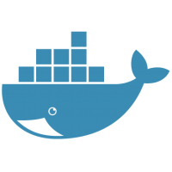

docker For Beginners
Hello!
I am Kshamesh Atnoorkar
Microsoft.NET Programmer using C#

Slide 2
Life before Docker
What is Docker?
Docker Vs Virtual Machine
Installation of Docker
Life Cycle of Docker Container
Docker Commands Cheat Sheet

Slide 3
Docker Architecture
Dockerfile
Docker Volumes
Docker Compose
Q&A, Conclusion
Further Learning

Slide 4
“Sometimes life gives us a lesson sent in a ridiculous packaging.”
- Dar Williams
Notes:
Dar Williams - is one of the famous American Singer and Song writer.
You might be thinking what this quote is doing here. The take away message here is whenever we have something ridiculously packaged weather it is life or software executables, and so weather it is life or software executables the only way to go beyond the ridiculous package is to accept it as a lesson and try to find the solution to overcome it. And trust me I am not here to talk about life lessons but to talk about the software ridiculous packages.

Slide 5
Life before Docker

Slide 6




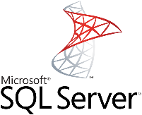


Life before Docker
Developer
Libraries
A typical developers life
Notes:
Let us imagine a developer is writing a webapp using .NET Core framework on ubuntu platform. Now he has finished his job and his app is ready to be shifted in QA environment to for quality testing.

Slide 7



Life before Docker
Developer
Quality Testing
Libraries
Libraries
Code works fine on my machine
There is some problem with your code.
Notes:
Quality testing environment would need the similar kind of setup in order to execute the webapp delivered by the Developer.
But look there seems a issue here. Talk about .NET Core framework compatibility.

Slide 8



Life before Docker
Staging
Environment
Production
Environment
Developer
Quality Testing
Libraries
Developer tried fixing the environment issues but no one knows whose responsibility it is.
I am not the only QA team member

Slide 9

Life before Docker
New Developer
Libraries
In between a new joiner comes in, can someone help me with setting up my machine?

Slide 10
The Solution

Slide 11

The Solution
We need something to hold all the software dependencies and can be ported on to other computers very easily and quickly as plug and play package.
Developer
Libraries

Slide 12
The Solution
Staging Environment
Developer not only gives the executable
application but also the compatible
environment to execute it
Quality Testing
Developer Environment
Production Environment
Developer
Notes:
Build once and run in any environment.

Slide 13
What is Docker?

Slide 14
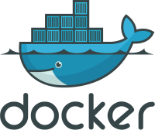
What is Docker?
Docker is an open platform for developing, shipping and running applications quickly.
Docker provides the ability to package and run an application in a loosely isolated environment called a container. It is also known as Containerization.
Containerization is OS-level virtualization method which enables to deploy and run applications without launching whole virtual machine.
Develop your application and its supporting components using containers.
The container becomes the unit for distributing and testing your application.
Notes:
Talk about size of Docker Images

Slide 15
Docker vs Virtual Machine

Slide 16
Docker vs Virtual Machine
Docker Architecture
Virtual Machine Architecture
App1
App2
App3
App1
App2
App3
Bins/Lib
Bins/Lib
Bins/Lib
Guest OS
Guest OS
Guest OS
Container Engine
Hypervisor
Host Operating System
Host Operating System
Hardware
Hardware
Notes:
Docker Architecture. Container Engine is installed by Docker tool/software. e.g.
Ubuntu container and includes only the lib requirement to execute app.
A container doesn’t have it’s own kernel, it is void of kernel. Container shares the resources from operating system, it only contains only executables and library to execute that app. So this makes they light weight.
Virtual Machine Architecture – they are heavy in nature. Hypervisor or kind of Virtual Box – virtualizes the hardware’s. Then you have whole of operating system, your size of VM is bigger. Depends on specification of VM.

Slide 17
Docker Installation

Slide 18


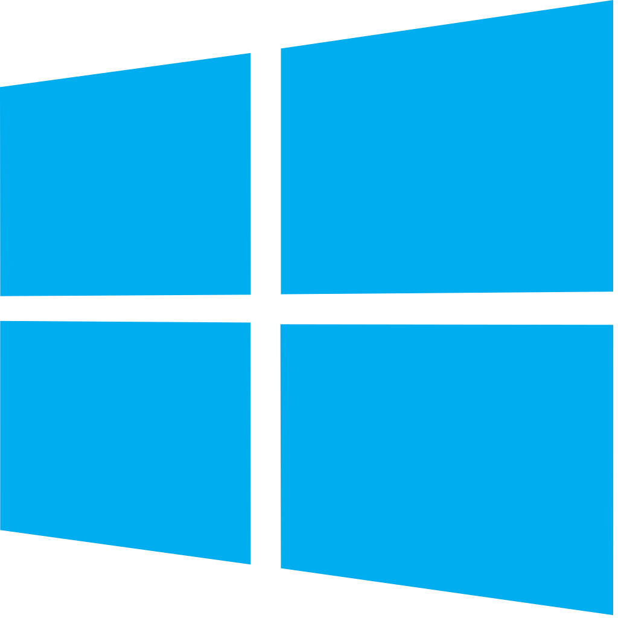
Docker Installation
Install Docker Toolbox on macOS and Windows
Install Docker on Ubuntu
https://docs.docker.com/toolbox/toolbox_install_mac/
sudo apt-get update
sudo apt-get install docker.io
https://docs.docker.com/toolbox/toolbox_install_windows/
Notes:
I have already a unix server which has got the docker setup alra

Slide 19
Docker Container Life Cycle

Slide 20



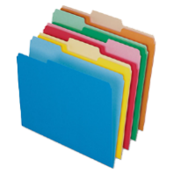

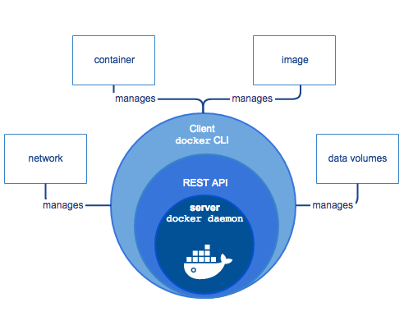

Docker Container Life Cycle
Docker Hub
Push
Run
Pull
Docker Engine
Docker Engine
Docker Images
Container Stages
Delete
Notes:
Docker hub is similar to github.
You pull the image on your local docker engine = which is nothing but container engine layer which we just saw in Docker Container Architecture in previous slide. It consist of the mainly three components there is persistent docker 1.daemon process which is responsible of managing docker images + containers + networks + volumes 2.RestAPI which establishes the communication between the docker 3.client CLI and docker daemon process.
A running instance of an Docker Image is called a container. Three states of container, running, you can stop it and you can remove it.

Slide 21
Docker Cheat Sheet

Slide 22


Docker Cheat Sheet
Build
Share
Build an image from the Dockerfile in the current directory and tag the image
docker build –t myimage:1.0
List all images that are locally stored with the Docker Engine
docker image ls
Delete an image from the local image store docker image rm alpine:3.4
Pull an image from a registry
docker pull myimage:1.0
Retag a local image with a new image name and tag
docker tag myimage:1.0 myrepo/ myimage:2.0
Push an image to a registry
docker push myrepo/myimage:2.0

Slide 23

Docker Cheat Sheet
Run
Run a container from the Alpine version 3.9 image, name the running container “web” and expose port 5000 externally, mapped to port 80 inside the container.
docker container run --name web -p 5000:80 alpine:3.9
Stop a running container through SIGTERM docker container stop web
Stop a running container through SIGKILL docker container kill web
List the networks
docker network ls
List the running containers (add --all to include stopped containers)
docker container ls
Delete all running and stopped containers docker container rm -f $(docker ps -aq)
Print the last 100 lines of a container’s logs docker container logs --tail 100 web

Slide 24
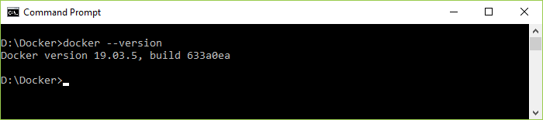
Docker Commands
docker --version
This commands helps you to know the installed version of Docker on your system

Slide 25
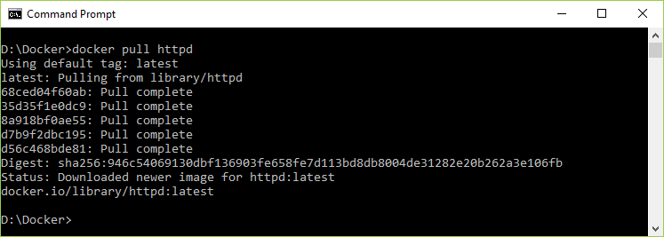
Docker Commands
docker pull imagename
This command helps you to pull the specified image from the docker central repository.

Slide 26
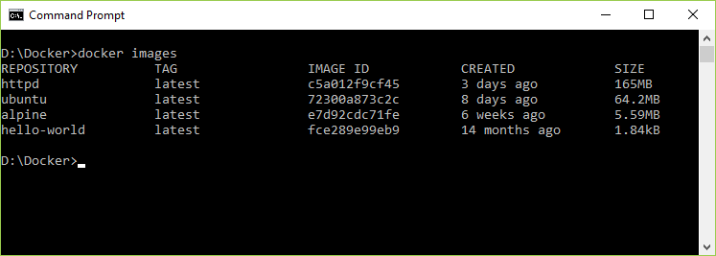
Docker Commands
docker images
This command helps you list the images that you have downloaded on your system.

Slide 27
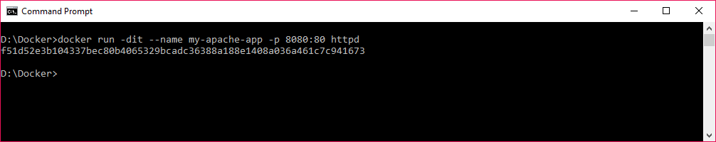
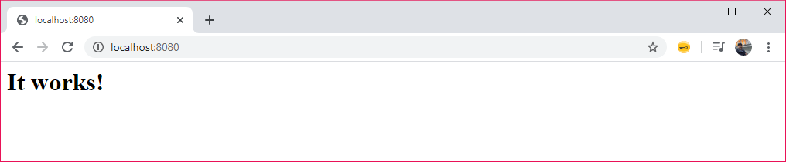
Docker Commands
docker run imagename
This command helps you to run the container using it’s image name.

Slide 28
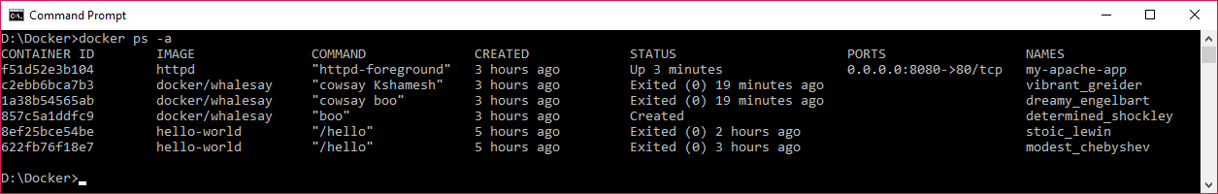
Docker Commands
docker ps
This commands retrieve the list of all containers on your system, -a flag is added to see the current + historic containers

Slide 29
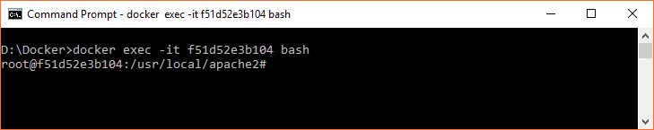
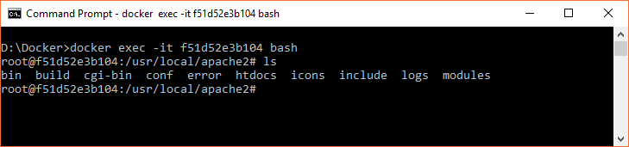
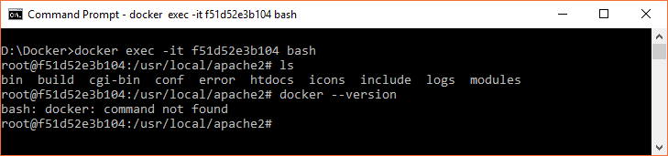
Docker Commands
docker exec containerid
If you can use exec command for logging/accessing the container.

Slide 30
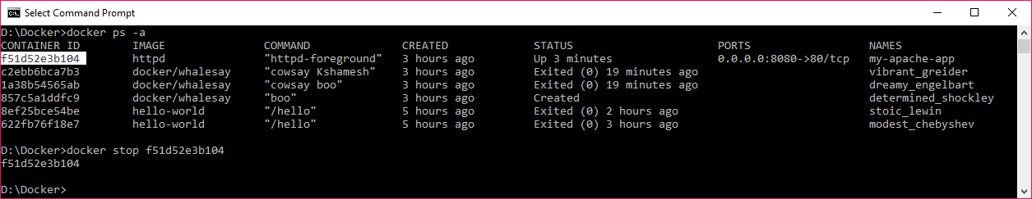
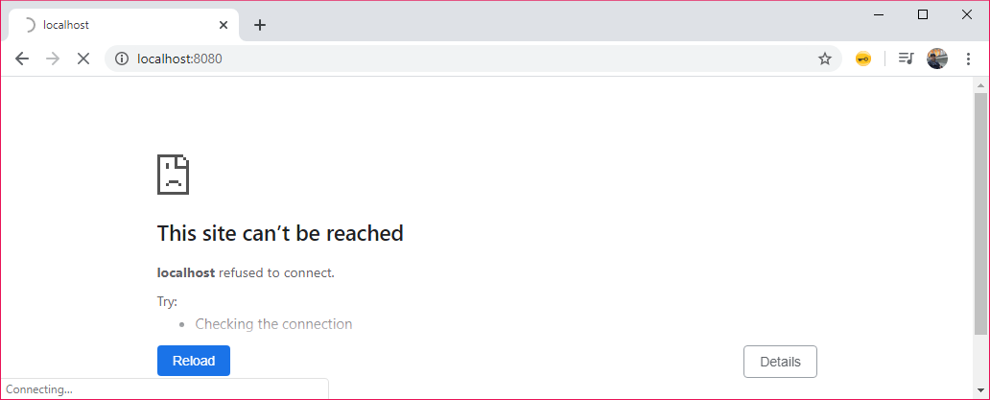
Docker Commands
docker stop containerid
This command helps you to stop the container which is already in run state.

Slide 31
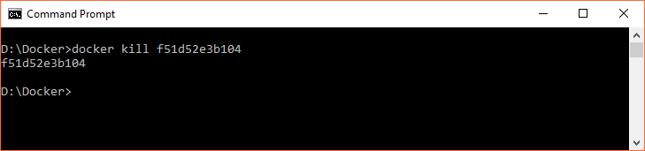
Docker Commands
docker kill containerid
The difference between kill and stop command is; kill command shuts down the container immediately and stop command stops shuts down the container gracefully. Kill command is used when containers are stuck and unable to respond when we try to stop them gracefully.

Slide 32
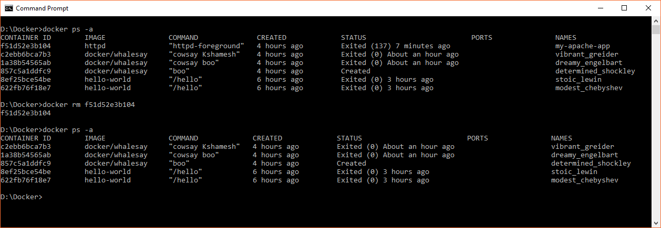
Docker Commands
docker rm containerid
We use this command to remove the stopped container from the system.

Slide 33
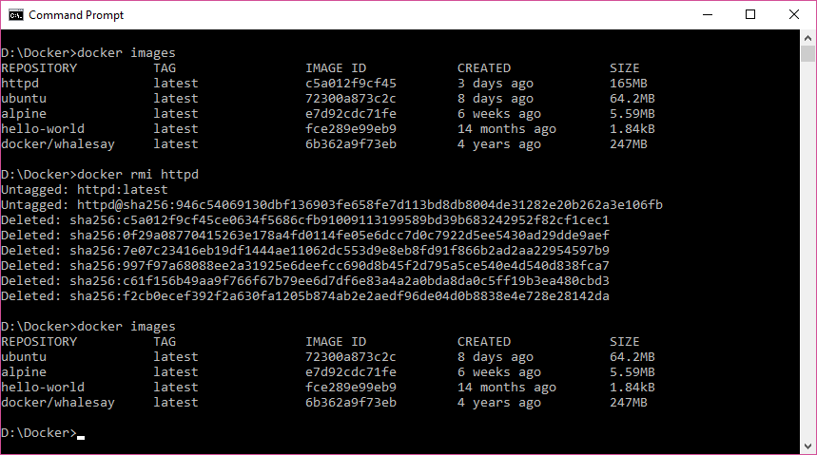
Docker Commands
docker rmi imagename
This command is used to remove the image from your system when we no longer need it

Slide 34
Docker Architecture

Slide 35






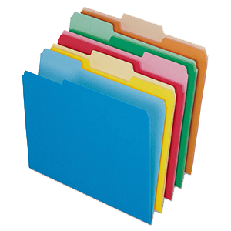

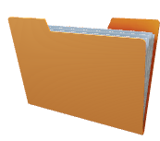
BUILD
PULL
RUN
Docker Architecture
DOCKER HOST
CLIENT
REGISTRY
DAEMON
DOCKER HUB
OR
REMOTE API
CONTAINERS
IMAGES
Notes:
Client – Server Architecture
Docker Client
User-Client-Server where we run the various commands it could be installed on your own environment, e.g. show me the total images.
It communicates through using REST API.
Docker client can communicate with more than one DAEMON.
Docker Host is a execution environment for containers and images to run the application. It receives the commands through CLIENT or REST API’s from the Docker client through UNIX Socket or Network Host.
Registry stores the docker images and is hosted publicly. Docker is configured to search for an image on Docker hub by default. You can run even your private registry

Slide 36
What is Dockerfile?

Slide 37

What is Dockerfile?
A Dockerfile is a text document that contains all the commands a user could call on the command line to assemble an image.
Using docker build users can create an automated build that executes several command-line instructions in succession.
Notes:
How do you want to customize your container? Install the software, came out of it, push the changes.

Slide 38

What is Dockerfile?
Commands
The ENTRYPOINT keyword is used strictly to run commands the moment the container initializes. The difference between CMD and ENTRYPOINT is, ENTRYPOINT will run irrespective of the fact weather argument is specified or not.
The ENV keyword is used to define environment variable in the container run time.
The FROM keyword is used to define the base image, on which we will be building.
The ADD keyword is used to add files to the container being built. The syntax which is followed is
ADD <SOURCE> <DESTINATION in container>
The RUN keyword is used to add layers to the base image, by installing components. Each RUN statement, add a new layer to the docker image.
The CMD keyword is used run commands on the start of the container. These commands run only when there is no argument specified while running the container.
EXAMPLE
FROM ubuntu
RUN apt-get update
RUN apt-get –y install apache2
ADD . /var/www/html
ENTRYPOINT apachectl –D FOREGROUND
ENV name DevOps learnDocker
Dockerfile
Notes:
Rather than everything manually we prefer to create Dockerfile.
From ubuntu image – base image
ADD you want to add some html file or some other file in your container.
Want to run any command apt-get update get the latest packages on the ubuntu –y install apache2
CMD vs Entrypoint CMD will not run if you provide the argument but entrypoint will run irrespective if you provide argument or not
1.Html file can be added during the demo and run

Slide 39
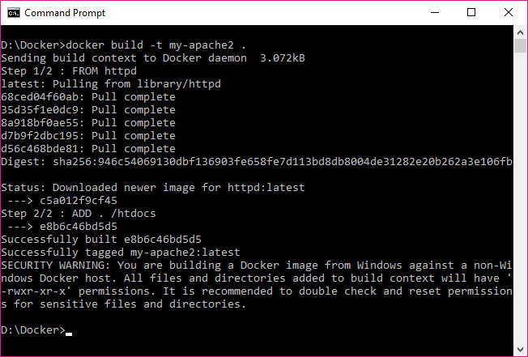
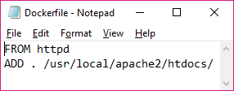
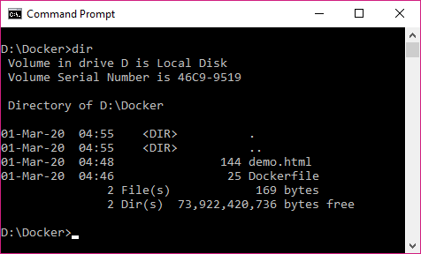
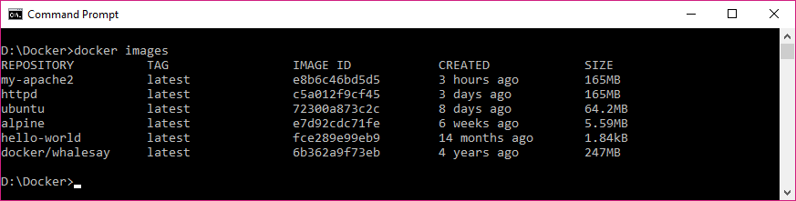
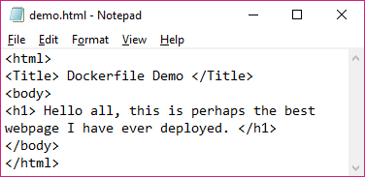
What is Dockerfile?
3
1
2
4

Slide 40
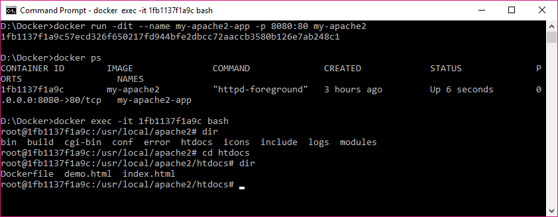
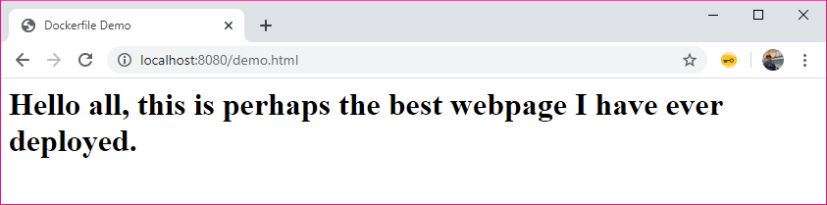
What is Dockerfile?

Slide 41
Introduction to Docker Volumes

Slide 42

What is Docker Volumes?
Docker Volumes are used to persist data across the lifetime of a container.
Docker has two options for containers to store files in the host machine, so that the files are persisted even after the container stops: bind mount and volumes.
HOST
Makes it easy to get the data out of the container if another process needs it.
Container
bind mount
You can move the data easily somewhere else
volumes
Filesystem
Docker Area
Notes:
Imagine it this way, you launched the container and you made some changes in the container. E.g. you added some html file or something. And the container was stopped or it was deleted. And you if reopen the container, then you won’t be able to see the file that was added, but you are in need of this file. So this point of time docker volumes comes into picture. So what does this mean you host the storage of the data outside the container, it maps to some directory inside the container. Location is mapped between container and docker host.

Slide 43

What is Docker Volumes?
bind mount
HOST
When you use a bind mount, a file or directory on the host machine is mounted into container.
The file or directory is referred by it’s full or relative path on the host machine.
They rely on the host machine’s file system having specific directory structure available.
Bind mount has limited functionality compared to
Volumes, but they are very performant.
docker run –v /home/ubuntu/directoryname:/app –d ubuntu
Container
bind mount
volumes
Filesystem
Docker Area
Notes:
It mounts the particular location inside the container, you can map the docker file folder inside the container. So if you make any change in the directory inside the docker host the same change would be available in the docker container directly. There is disadvantage of bind mount, the file structure needs to be same. If you configure the bind mount then push your image on docker hub and someone else pull the same image with same bound mount. E.g. windows operating system is trying to use this container then it would not work as expected.

Slide 44
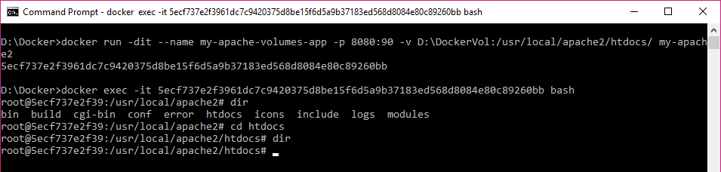
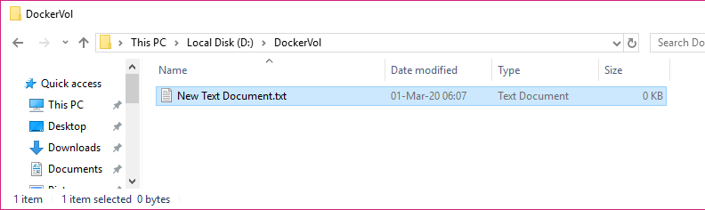
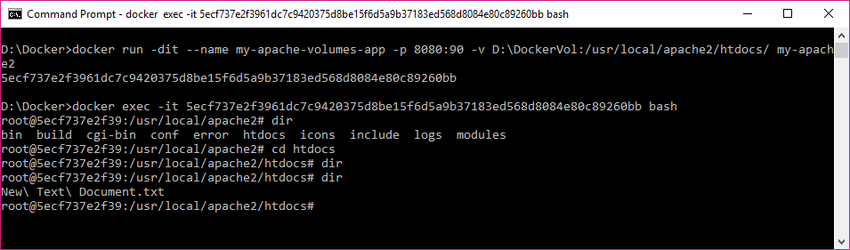
What is Docker Volumes?
1
2
3

Slide 45
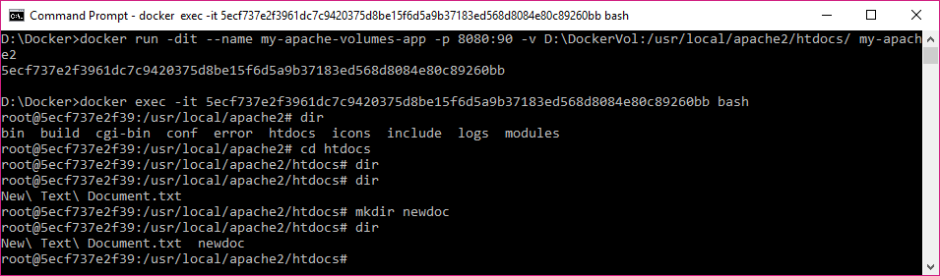
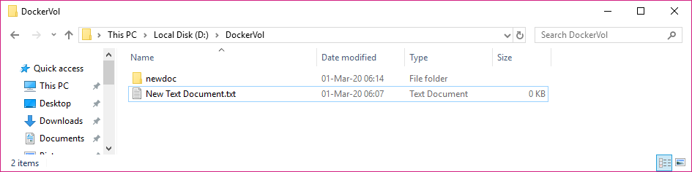
What is Docker Volumes?

Slide 46
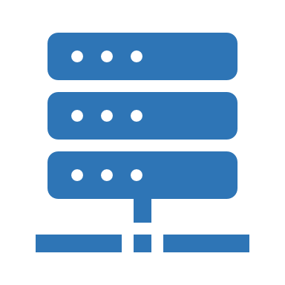
What is Docker Volumes?
volumes
HOST
Volumes are completely managed by Docker, they are not dependent on directory structure of host machine.
Volumes are easier to back up or migrate than bind mounts and safely shared among multiple containers.
Volumes let you store on remote hosts or cloud providers.
Volumes are often a better choice because volume does not increase the size of containers using it.
Create a volume
docker volume create <name-of-volume>
List all the volume present on your system
docker volume ls
Attach volume to container
docker run –it –mount source=<name-of-volume>, target=<path-to-directory> -d <image-name>
Container
bind mount
volumes
Filesystem
Docker Area
Notes:
One of the key difference between the bind mount and volumes is that volumes are managed by docker and they are independent of directory structure of host machine.
Docker engine automatically decides the where the volumes exists. Volumns are easy to back up or migrate. We don’t need to bother where the volumns are stored.

Slide 47
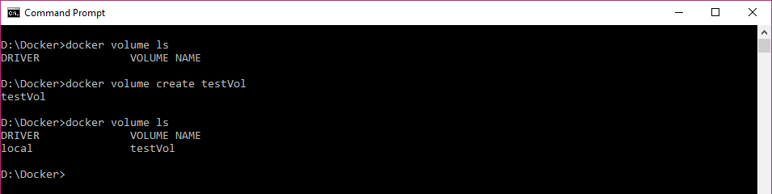
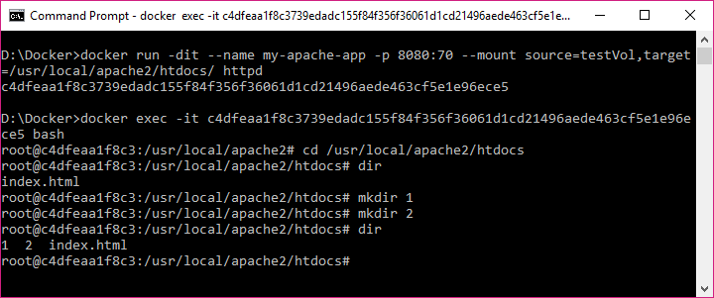
What is Docker Volumes?

Slide 48
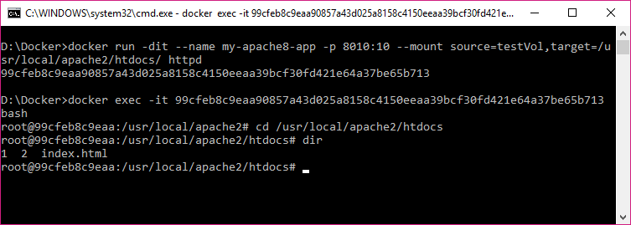
What is Docker Volumes?

Slide 49
What is Docker Compose?

Slide 50
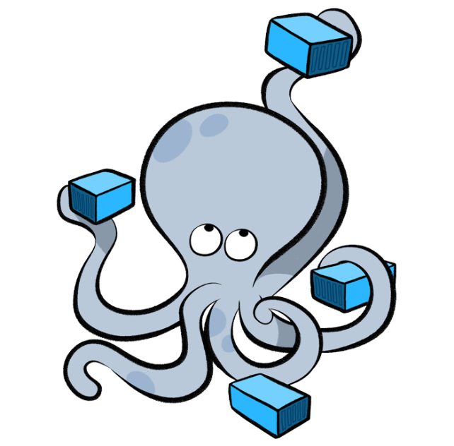
What is Docker Compose?
Docker Compose is a tool for defining and running multi-container Docker applications. With Compose, you use a YAML file to configure your application’s services. Then, with a single command, you create and start all the services from your configuration.
Run docker-compose up command and compose starts and runs your entire app.
Use case
You can break a monolithic application into micro-services architecture app
Notes:
Create and configure multiple container running at the same, and launching at the same time.

Slide 51
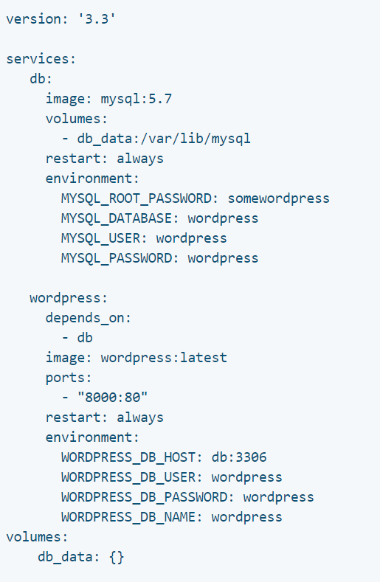
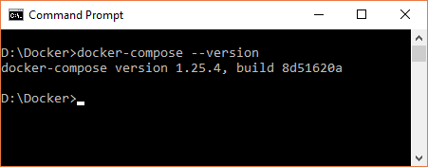
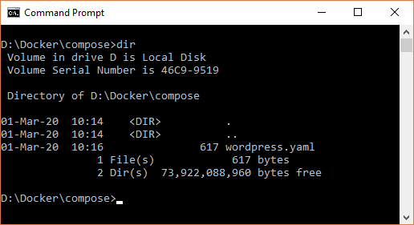
docker-compose.yaml
What is Docker Compose?
Notes:
Talk about all the aspects of docker-compose file.
If you have installed docker using tool box, then docker compose is installed out of the box. But if you have installed docker community edition then you need to install docker compose separately.

Slide 52
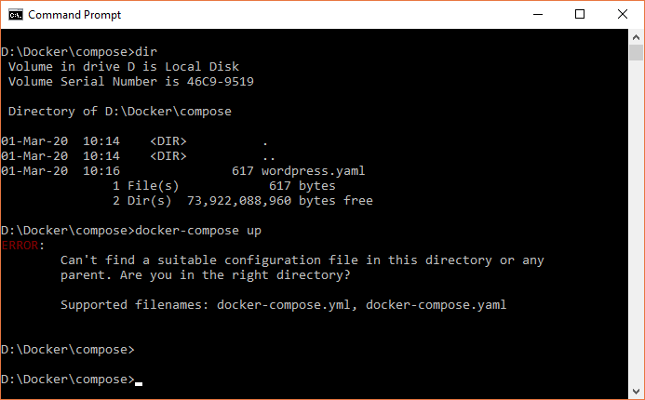
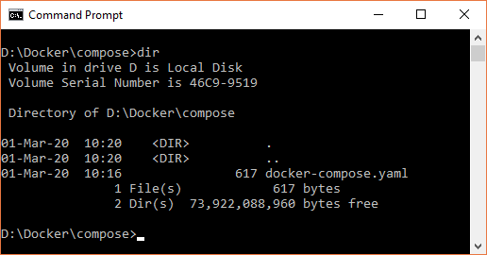
What is Docker Compose?

Slide 53
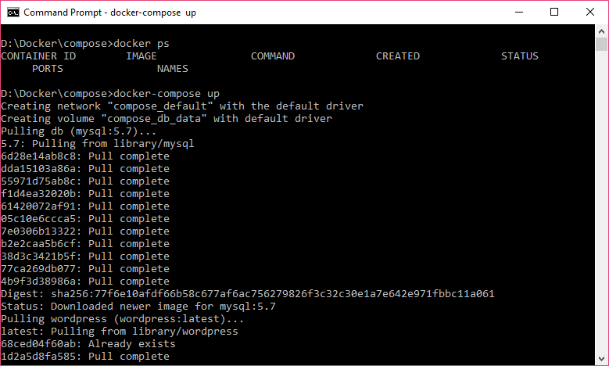
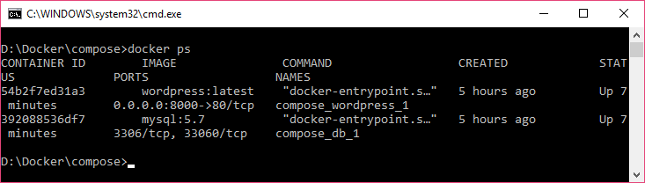
What is Docker Compose?

Slide 54
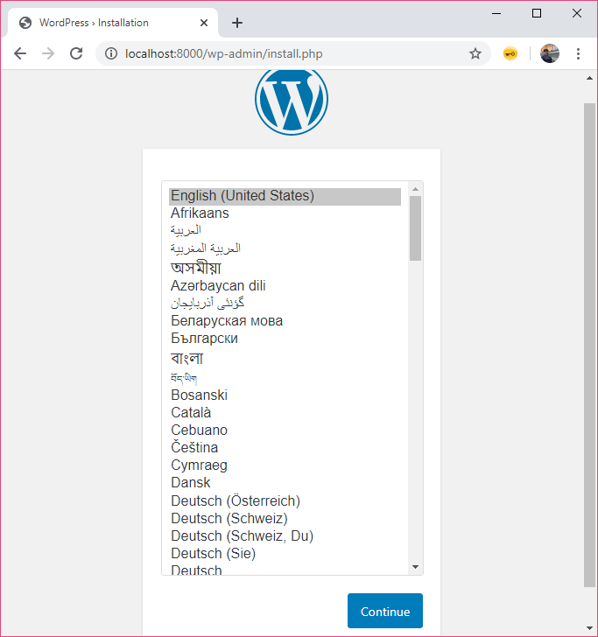
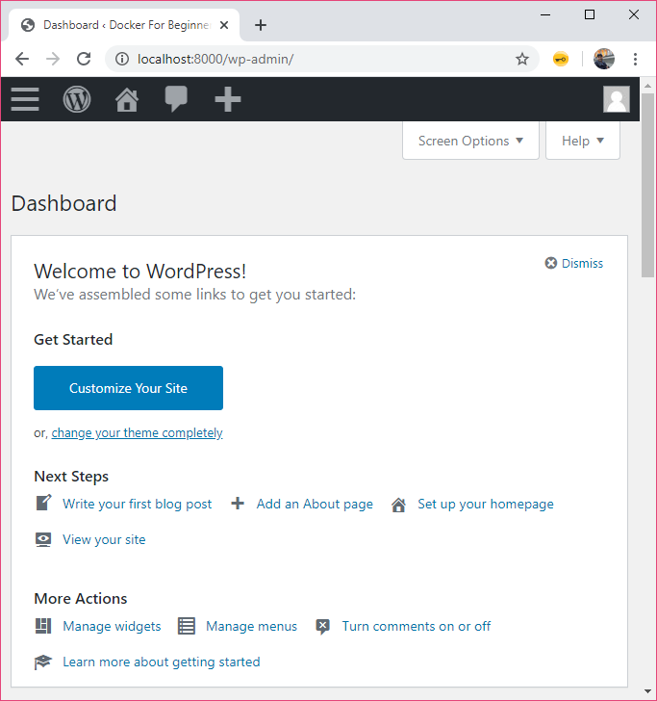
What is Docker Compose?

Slide 55
Conclusion and further learning.

Slide 56


Conclusions and further learning
What can I use docker for?
Further Learning
Fast, consistent delivery of your applications
Responsive deployment and scaling
Running more workloads on the same hardware
Docker Swarm
Docker Networking
Kubernetes

Slide 57
Q & A

Slide 58
Thank you!

